Slide 1
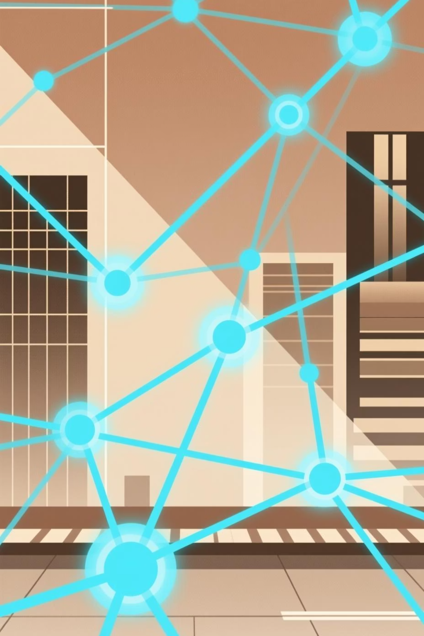
What Is AI?
Module 1: Building a Foundation for Understanding Artificial Intelligence

Slide 2


Your Journey in This Module
Move Beyond Buzzwords
Build Realistic Expectations
Separate AI reality from science fiction and headlines to understand what AI truly is and isn't.
Develop a grounded perspective on AI's capabilities and limitations in the real world.
Discover Practical Applications
Explore how AI appears in your everyday life and workplace, often without you even noticing.

Slide 3

Learning Outcomes
By the end of this module, you'll be equipped with essential AI knowledge and skills:
01
02
03
Define AI Clearly
Recognize AI in Action
Understand AI as a Tool
Articulate what AI can and cannot do, distinguishing capabilities from myths.
Identify AI systems in everyday tools, from smart assistants to recommendation engines.
Differentiate artificial intelligence from human consciousness and thinking.
04
05
Apply Ethical Awareness
Collaborate Creatively
Appreciate why human judgment, oversight, and context remain essential.
Approach AI as a collaborative partner rather than a human replacement.
Icebreaker Question: "When you hear 'AI,' what comes to mind—robots, chatbots, Skynet, Siri, something else?" Share 3–5 responses to uncover assumptions and spark discussion.

Slide 4
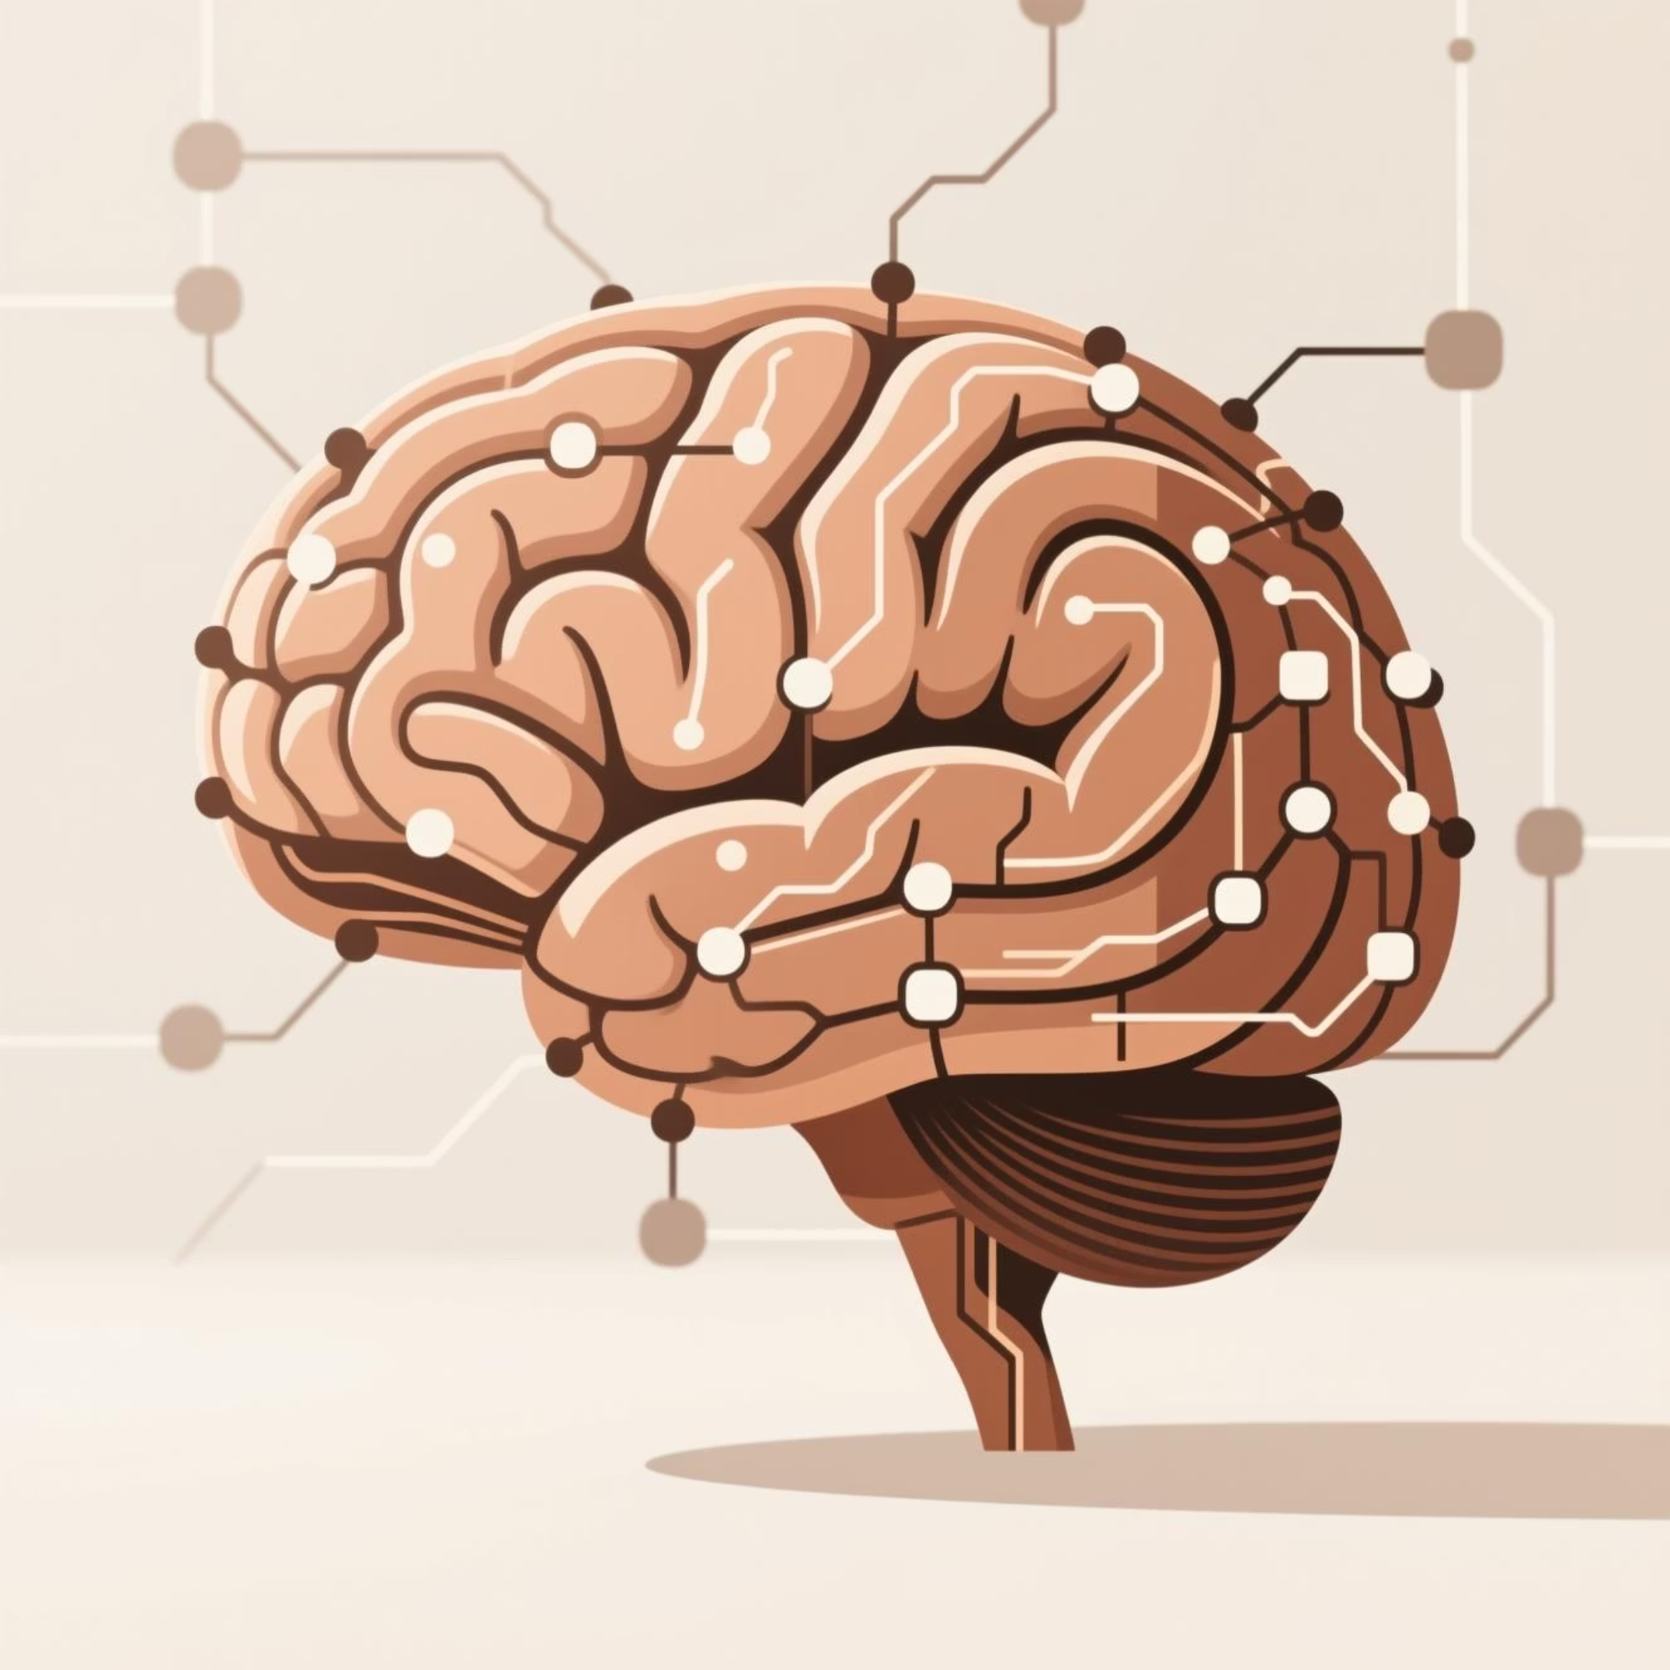
Defining Artificial Intelligence
AI = Skills, Not Sentience
Artificial Intelligence refers to computer systems designed to perform tasks that typically require human intelligence—but without consciousness or self-awareness.
Tasks AI Can Simulate
Language Comprehension
Problem-Solving
Understanding and generating text through chatbots, virtual assistants, and translation services.
Route planning, scheduling optimization, and solving complex computational puzzles.
Pattern Recognition
Decision-Making
Identifying cats in photos, detecting fraud, analyzing medical images with precision.
Recommending movies, adjusting smart thermostats, predicting outcomes based on data.
Key Insight: AI replicates specific human skills using algorithms, mathematics, and data patterns—it does not replicate human consciousness or understanding.

Slide 5



AI Is a Tool, Not a Mind
What AI Is Not
What Makes AI Powerful
Conscious or Self-Aware
Massive Datasets
AI has no internal experience or awareness of itself.
Learns from millions or billions of examples to recognize patterns.
Emotionally Intelligent
It can simulate tone but doesn't truly feel emotions.
High-Speed Processing
Human-Like Understanding
Analyzes information exponentially faster than any human could.
AI processes patterns, not meaning or context like we do.
Subtle Pattern Detection
Identifies relationships and correlations humans might overlook.
Think of AI Like...
A calculator for words and ideas that processes language at scale
A pattern detector with superhuman speed but no genuine comprehension
A tireless team member that needs clear instructions and human guidance

Slide 6

Activity: Explain AI to a 10-Year-Old
Your Challenge
Example Response
Write 2–4 sentences explaining AI as if you're talking to a 10-year-old child. Make it simple, clear, and relatable—no technical jargon allowed!
"AI is like a super-smart helper that learns by looking at lots of examples. It can recognize pictures, understand words, and answer questions. It doesn't think like a person, but it helps us do things faster—like when your tablet suggests the next video you might like!"
Guiding Prompts
How would you explain AI without using technical words?
What's one example from daily life that a child would recognize?
How can you make it fun or relatable for a young audience?
Optional Extension
Pair up with another learner and exchange your explanations. Give each other feedback on clarity and simplicity.
Time Allocation: 5–7 minutes

Slide 7

Module 1 Summary
Congratulations! You've built a solid foundation for understanding AI. Here's what you now know:
AI Is a Tool, Not a Person
It performs tasks without consciousness, emotions, or self-awareness—powerful but not sentient.
Powered by Data and Patterns
AI learns from massive datasets and identifies patterns at superhuman speed to complete tasks.
Present in Everyday Life
From smart assistants to movie recommendations, AI works quietly in the background of modern life.
Requires Human Partnership
AI works best when humans provide guidance, supervision, context, and ethical oversight.

Slide 8
Facilitator Guide: Key Teaching Points
Welcome & Expectations
1
Engage learners with the icebreaker question to surface preconceptions. Transition: "Some ideas are accurate, some are myths—let's start with a clear definition."
2
Defining AI
Emphasize that AI performs tasks, not thinks or feels. Use relatable examples: Siri, Netflix recommendations, smart home devices. Ask: "Which AI skill do you interact with most daily?"
AI as a Tool
3
Clarify that AI simulates understanding through pattern recognition, not consciousness. Optional demo: show a chatbot's tone vs. genuine emotion to illustrate the difference.
4
Activity Guidance
Encourage creativity and simplicity. Walk around providing gentle suggestions: "Can you simplify that further?" Debrief by highlighting the clearest, most creative explanations.
Module Wrap-Up
5
Reinforce that AI is a powerful tool, not human. Understanding basics enables responsible use. Transition: "Next, we'll explore how AI works under the hood—Machine Learning, neural networks, and language models."

